Slide 2


Slide 3


Database Management Systems FOOD TOPIA
By
CH CHAITHANYA MADHAV (2110030326)
DANDU POOJITHA (2110030223)
K SRIMANNARAYANA (2110030122)
A LAXMI NARAYANA (2110030339)
Under the guidance of
(DR.SUMIT HAZRA)

Slide 4
Problem statement and domain
* An Online Food Ordering System is proposed here which simplifies the food ordering process.
*-The proposed system shows an user interface and update the menu with all
available options so that it eases the customer work.
*Customer can choose more than one item to make an order and can view
order details before logging off.
*The order confirmation is sent to the customer.
*The order is placed in the queue and updated in the database and returned in real time.
*This system assists the staff to go through the orders in real time and process it efficiently with minimal errors.

Slide 5
Existing solutions:
There are many ways to order the food
The two methods used are:
1. TAKE AWAY
2.SELF SERVICE
. The examples of TAKE AWAY are:
1.Swiggy
2.Zomato

Slide 6
Proposed Algorithm Design Technique
The main objective of the Online Food Ordering System is to manage the details of Item Category,Food,Delivery Address,Order,Shopping Cart. It manages all the information about Item Category, Customer, Shopping Cart, Item Category.
We are adding easy access to our application .
We are providing easy way to order the food through the web portal.

Slide 7
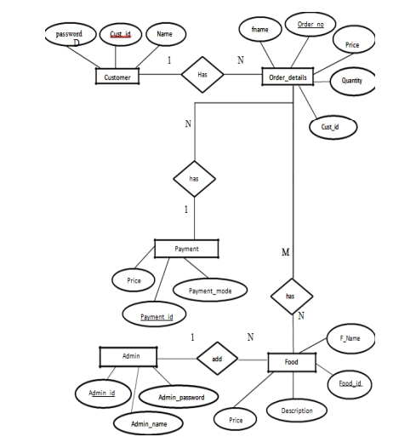
ER Diagram:

Slide 8
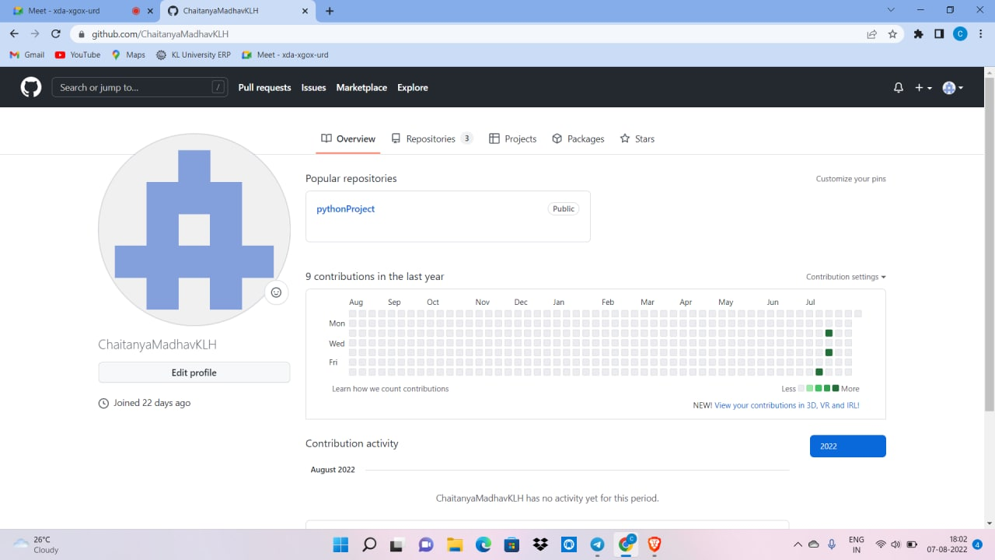
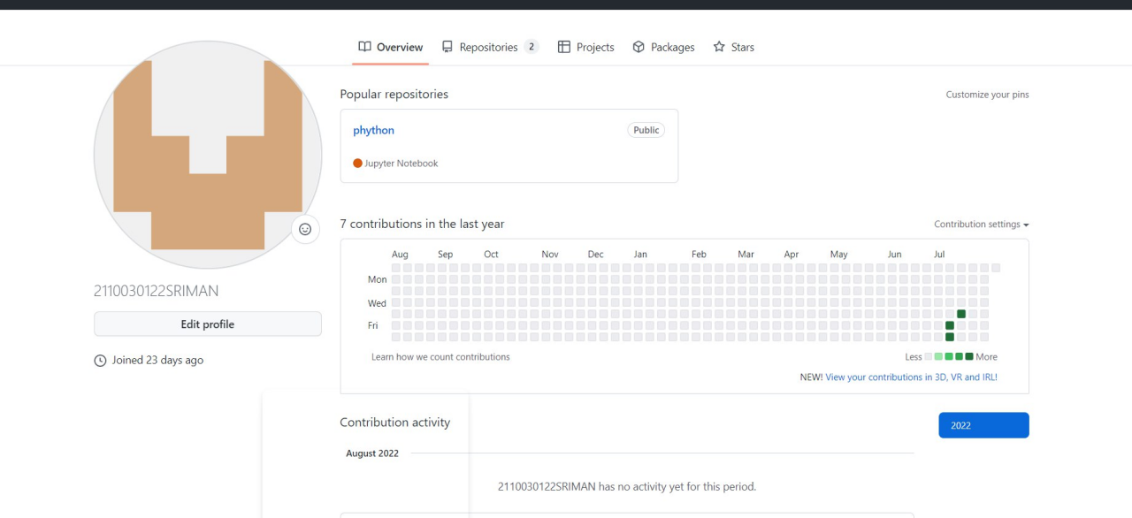
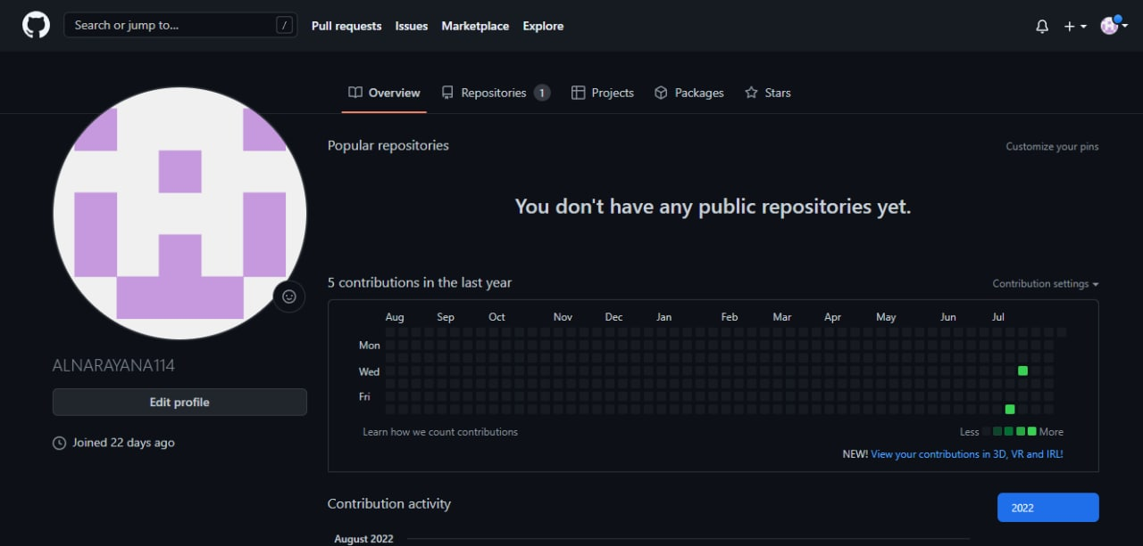
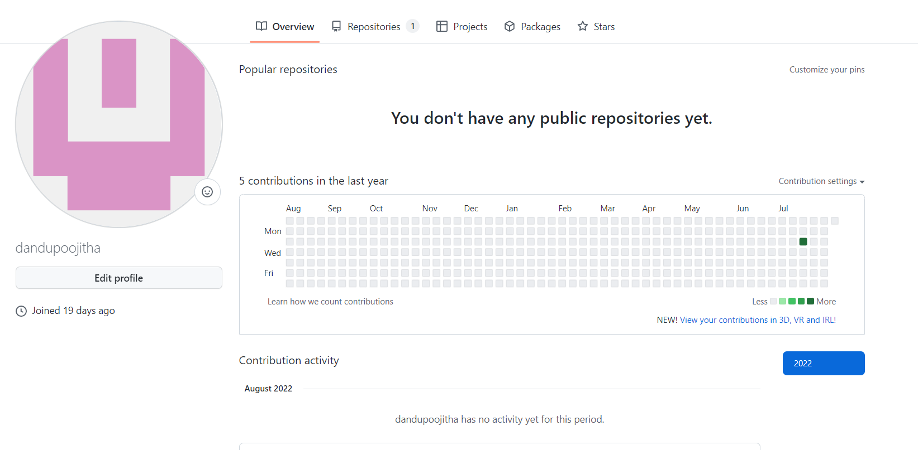
Github setup

Slide 9
Data Structures needed
A data structure is a specialized format for organizing, processing, retrieving and storing data.
There are several basic and advanced types of data structures, all designed to arrange data to suit a specific purpose.
We will be mainly Focusing on three main methods
Strings.
Recurssions.
Files
TOOLS:
MYSQL, TerraER, Django, HTML

Slide 10
Division of work among the group members
Web Application : K.Sriman Naryana
. Code development : CH.Chaitanya Madhav
Case diagram : Dandu.Poojitha
Data Collection : A. Lakshmi Narayana
Slides: Done by all team members

